Slide 1
PLANNING FOR ZERO-WASTE AT SCHOOLS
Key Principles
Waste hierarchy, where the focus is on preventing waste generation in the school compound to reduce the amount of waste generated;
Circular economy, where the aim is to close the loops of material and resources as close as possible to the production source so that more material and resources can be recycled inside and/or outside the school;
Behavior change and learning by doing, where the aim is that the whole school community can experience sustainable practices and that students are encouraged to adopt such practices in their daily lives.
Participatory strategic planning, where the aim is to involve a broad variety of school stakeholders to come up with an Action Plan towards Zero-Waste tailored to the school context, and which follows a structured approach allowing to take data-driven decisions;

Slide 2
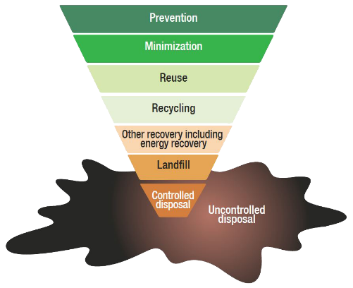
1. WASTE HIERARCHY
1° Priority focus: Minimize waste generation!
2° Priority focus: Foster recycling practices
3° Priority focus: Improve disposal practices
Wilson et al. 2015 – Global Waste Management Outlook

Slide 3
2. CIRCULAR ECONOMY
Linear Economy: Take – Make – Use - Discard
Eawag/Sandec - MOOC

Slide 4
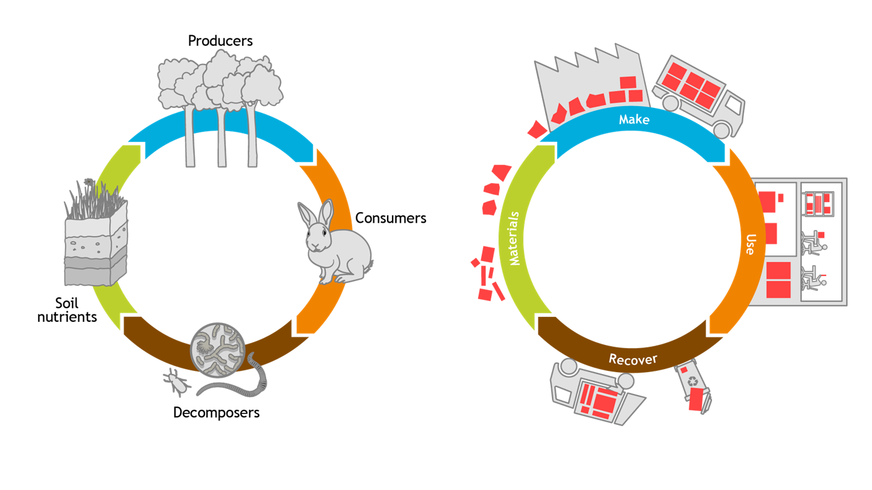
2. CIRCULAR ECONOMY
Circular Economy: Let’s look at Nature!
Eawag/Sandec - MOOC

Slide 5
2. CIRCULAR ECONOMY
Circular Economy: Make – Use – Recover – Materials
Eawag/Sandec - MOOC

Slide 6
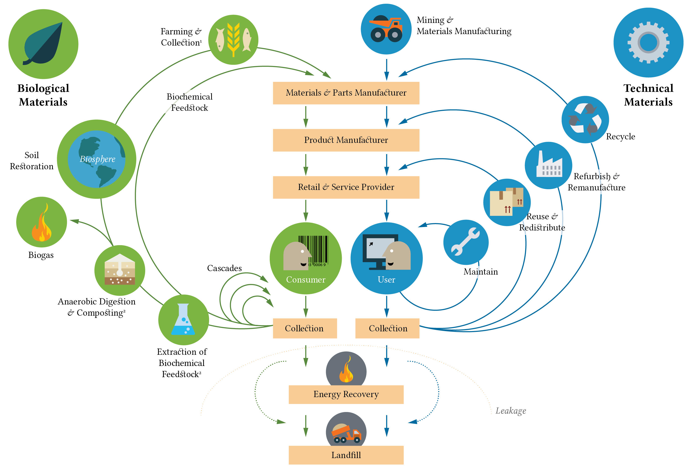
2. CIRCULAR ECONOMY
Ellen MacArthur Foundation (2013)

Slide 7
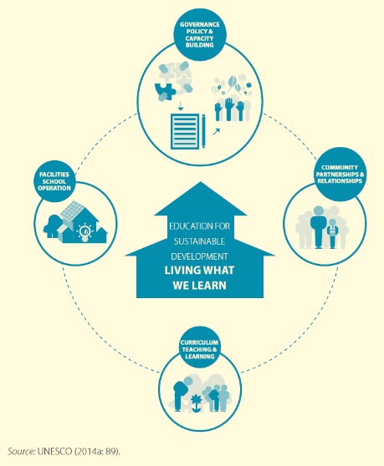
3. Behavior change and learning by doing
Important: When we ask someone to do something differently, we ask them for a behavior change!
The Whole-institution approach: “An institution-wide process is organized in a manner that enables all stakeholders – leadership, teachers, learners, administration – to jointly develop a vision and plan to implement education for sustainable development in the whole institution” (UNESCO, 2018)
Key pedagogical approaches (UNESCO 2018):
Learner-centered approach
Action-oriented learning
Transformative learning
UNESCO, Shaping the Future We Want. 2014

Slide 8
4. PARTICIPATORY STRATEGIC PLANNING
Mobilize → Assemble your team, agree on principles and process, confirm school commitment, identify stakeholders
Baseline → Establish a baseline on the current situation, identify key issues and validate the baseline
Planning priorities and principles → Set goals and targets, identify priorities,
Identify and evaluate options → Identify and evaluate options, discuss and agree on options, revisit goals and targets
Develop an Action Plan → Develop an Action Plan, identify roles, responsibilities and set targets
Implement the Action Plan → Start the implementation process, communicate priorities, objectives and targets to all stakeholders
Monitor and evaluate → Monitor and evaluate progress against targets set, identify opportunities for improvement, updates the Action Plan accordingly
UN-Habitat, Planning steps - Towards Zero Waste at school. 2021

